Slide 2
Non-intrusively Enable OpenKruise and Argo Workflow in a Multi-Cluster Federation
Tiecheng Shen, Volcano Engine
Rong Zhang, vivo

Slide 3
Agenda
Multi-cluster Federation Background
Challenges of Migration and Integration(take OpenKruise and Argo Workflow as examples)
Resource Interpreter Framework
Adoption in vivo

Slide 4
Multi-cluster Federation Background

Slide 5
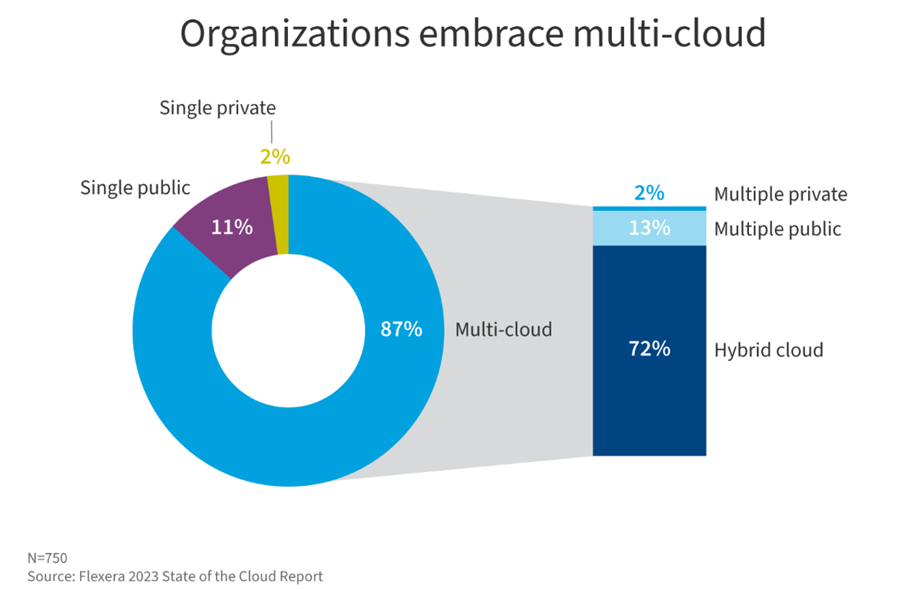
Why Multi-cloud
Notes:
More than 87% of enterprise respondents are using the services of multiple cloud at the same time.

Slide 6
Typical stages
Different stages of multi-cloud multi-cluster
Stage 1: Isolated Clusters
Consistent cluster operation and maintenance
Consistent application delivery
Resource islands
Stage 2: Cluster Fleet
Unified application delivery
Unified application access
Unified scheduling
Stage 3: Unified resource pool
Infinitely scalable cluster pools

Slide 7
Challenges
Challenges of managing multiple Kubernetes clusters
Problem 1: Too many clusters
Cumbersome and Repetitive setup
Incompatible Cluster Lifecycle API
Fragmented API endpoints
Problem 3: Boundary of Clusters
Resource Scheduling
Application Availability
Horizontal Auto-scaling
Problem 2: Workload Fragmentation
Per-cluster customization for Apps
Multi-cluster service discovery for Apps
Sync Apps between clusters
Problem 4: Vendor lock-in
Deployment Gravity
Lack of Migration Automation
Lack of independent projects in multi-cloud ecosystem

Slide 8
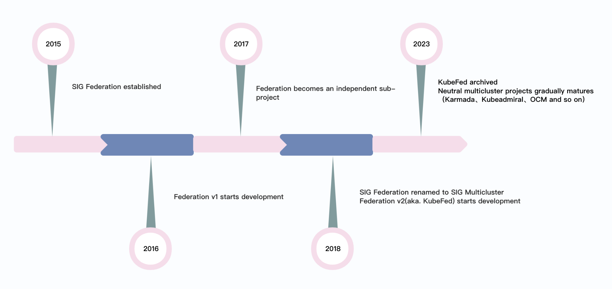
Community Timeline

Slide 9
Challenges of Migration and Integration

Slide 10
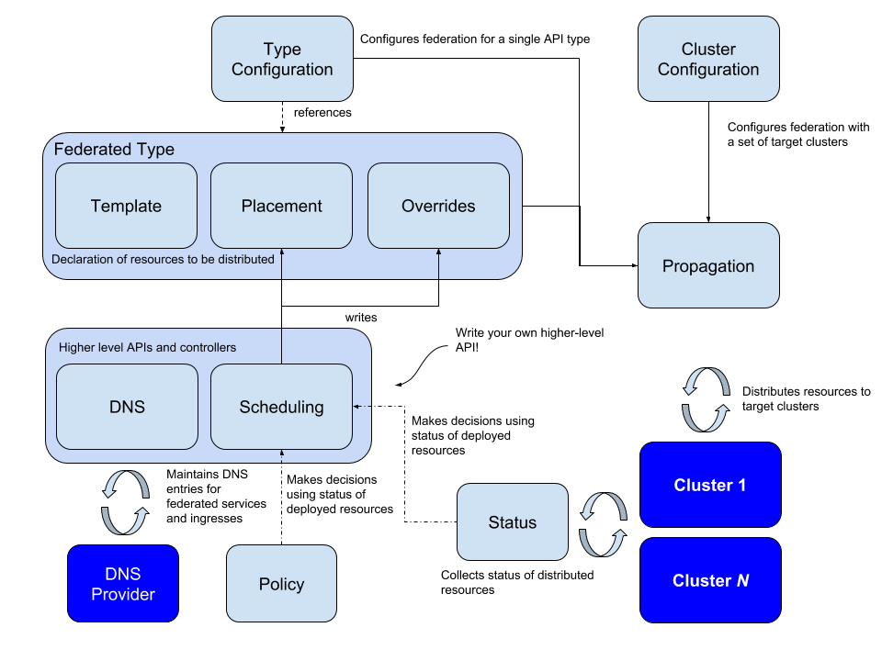
KubeFed’s Dilemma
Advantage
Modular design
Placement and override API structure
Disadvantage
Not compatible with K8s native APIs, especially the lack of expansion capabilities for CRDs, require extra learning and adoption efforts
Lack of turnkey solution, customizations on building blocks result in no standard

Slide 11
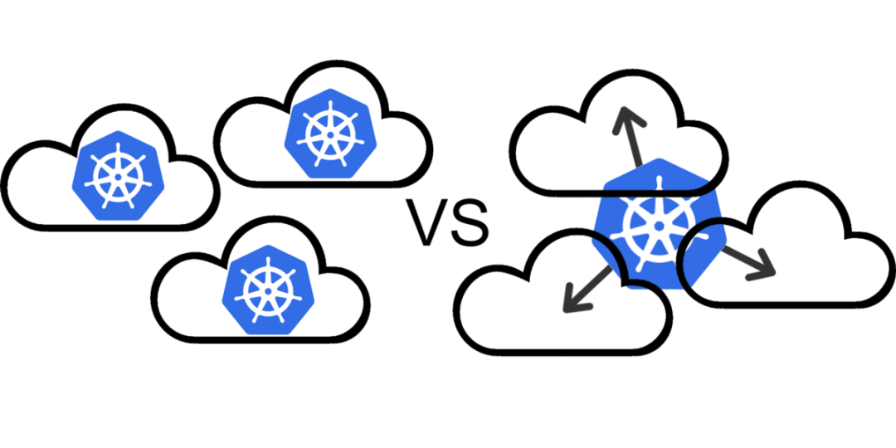
Migration and Integration
When users switch from a single-cluster architecture to a multi-cluster federation, the core demands of users are often
to reduce intrusive modifications as much as possible(migration)
be as compatible with the wider Kubernetes ecosystem as possible(integration)
However, KubeFed does not solve the above problem as well.

Slide 12
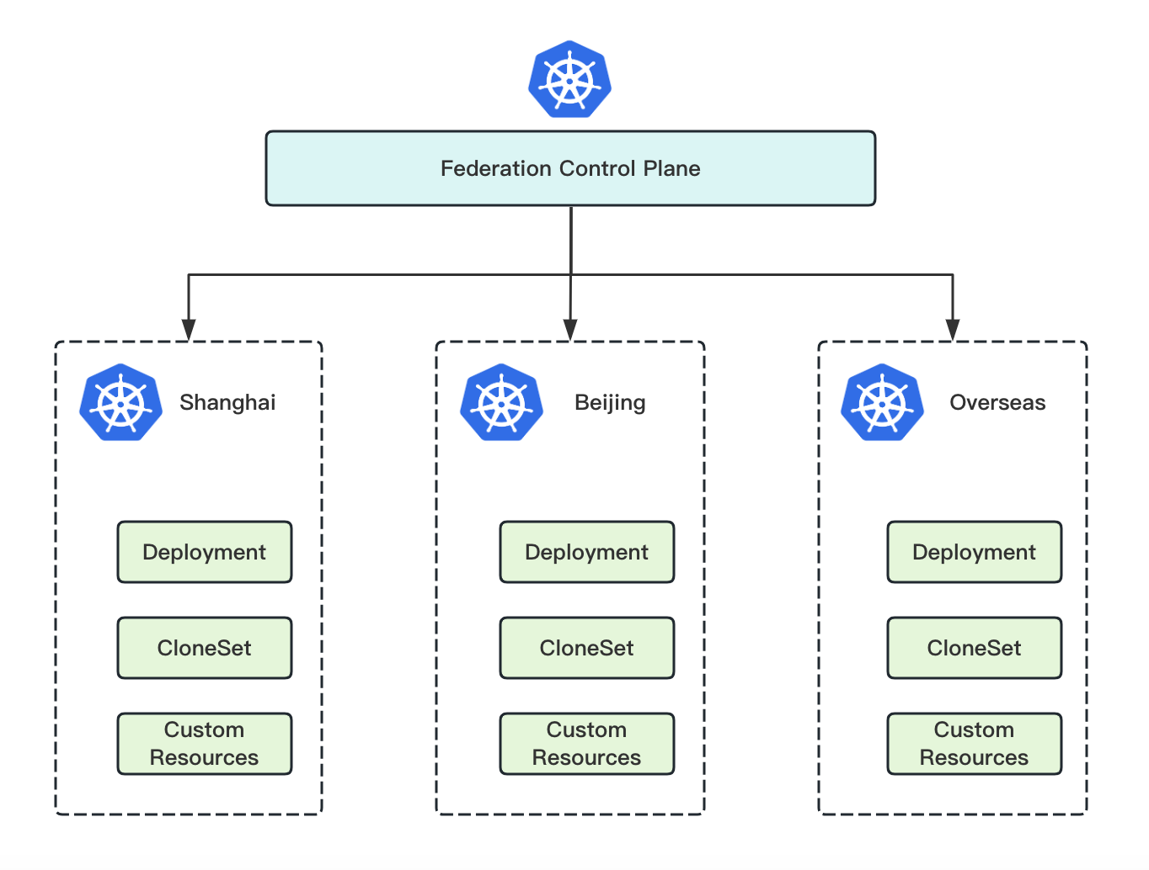
Typical Cases
Situation 1:
Assume we have several clusters and several kinds of workloads:
Deployment
CloneSet from OpenKruise
Custom Resources controlled by operators
We hope to:
Use a unified strategy to dynamically allocate replicas across multiple clusters
Which means we need to:
Resolve the replicas number of different workloads and their required resources

Slide 13
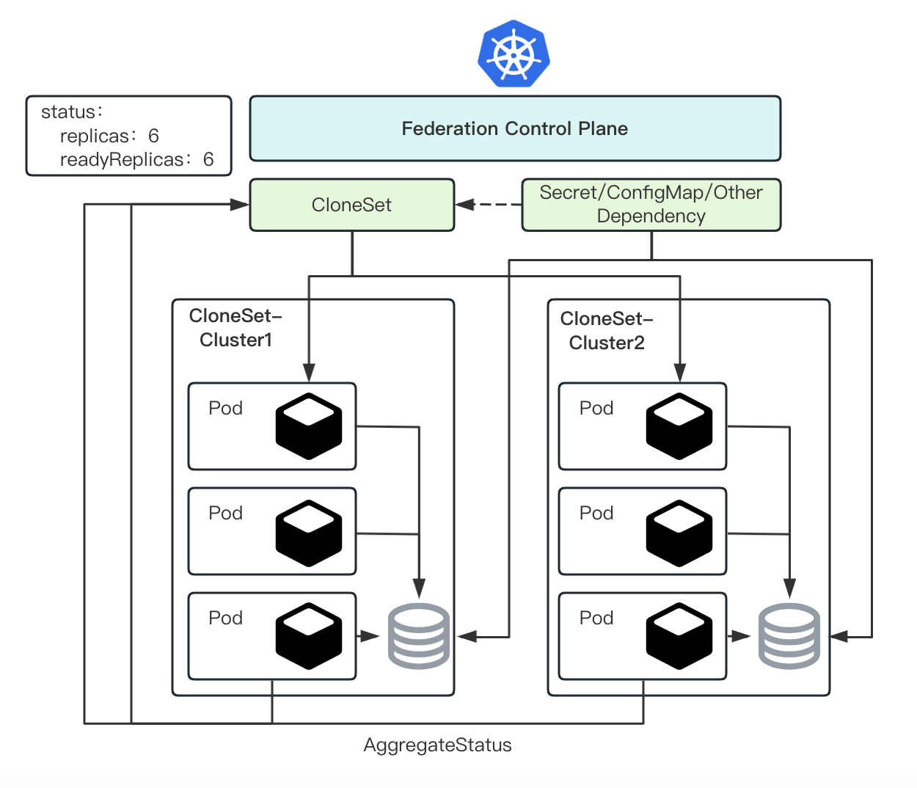
Typical Cases
Situation 2:
Assume we have registered several clusters into a federation and start to propagate workloads:
We hope to:
Automatically identify dependent objects of different CRDs
Aggregate the status of resource objects on different clusters
Which means we need to:
Resolve the dependency of different workloads
Resolve the status of different workloads and define how they are aggregated

Slide 14
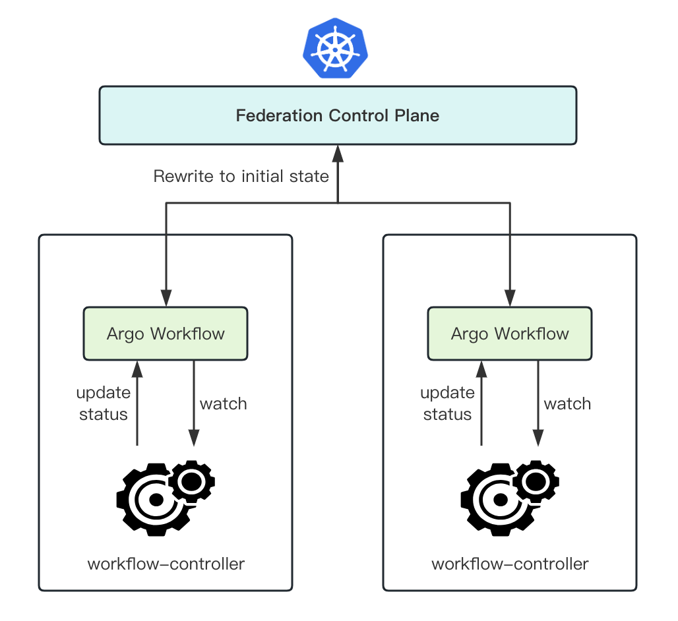
Typical Cases
Situation 3:
Assume we propagate several workflows to different clusters using a multi-cluster federation.
Since the federated controller and the operators in member clusters will update resource objects at the same time, resource objects will change repeatedly and deadlock will occur.
Typical cases:
workflow-controller updates the status
hpa-controller updates the replicas
Which means we need to:
Decide which value to use when a conflict occurs

Slide 15
Resource Interpreter Framework

Slide 16
Interpreter Operation
To solve the above problems, Karmada (a Multi-Cluster Kubernetes Orchestration) implements a common Resource Interpreter Framework to interpret resource structure. Users can customize resource interpreters based on their CRs.
Karmada defines several interpreter operations:
InterpretReplica: indicates how to figure out the replica declaration of a specific object.
ReviseReplica: indicates how to modify the replica by adopting the replica scheduling policy.
InterpretStatus: indicates how to figure out how to get the status.
Retain: indicates how to retain the desired resource template to resolve conflicts between federation and member clusters.
AggregateStatus: indicates how to figure out how to aggregate status to resource template.
InterpretHealth: indicates how to figure out the health status of a specific object.
InterpretDependency: indicates how to figure out the dependencies of a specific object.

Slide 17
Custom Interpreters
Resource Interpreter Framework consists of built-in and customized interpreters:
built-in interpreter: used for common Kubernetes native or well-known extended resources.
customized interpreter: interprets custom resources or overrides the built-in interpreters.
Running a webhook at runtime.
Defining declarative configuration. Users can quickly customize resource interpreters for both Kubernetes resources and CR resources by the rules declared in the ResourceInterpreterCustomization API specification.
ResourceInterpreterCustomization is a CRD which defines the implementation of interpreter operations by Lua scripts.

Slide 18
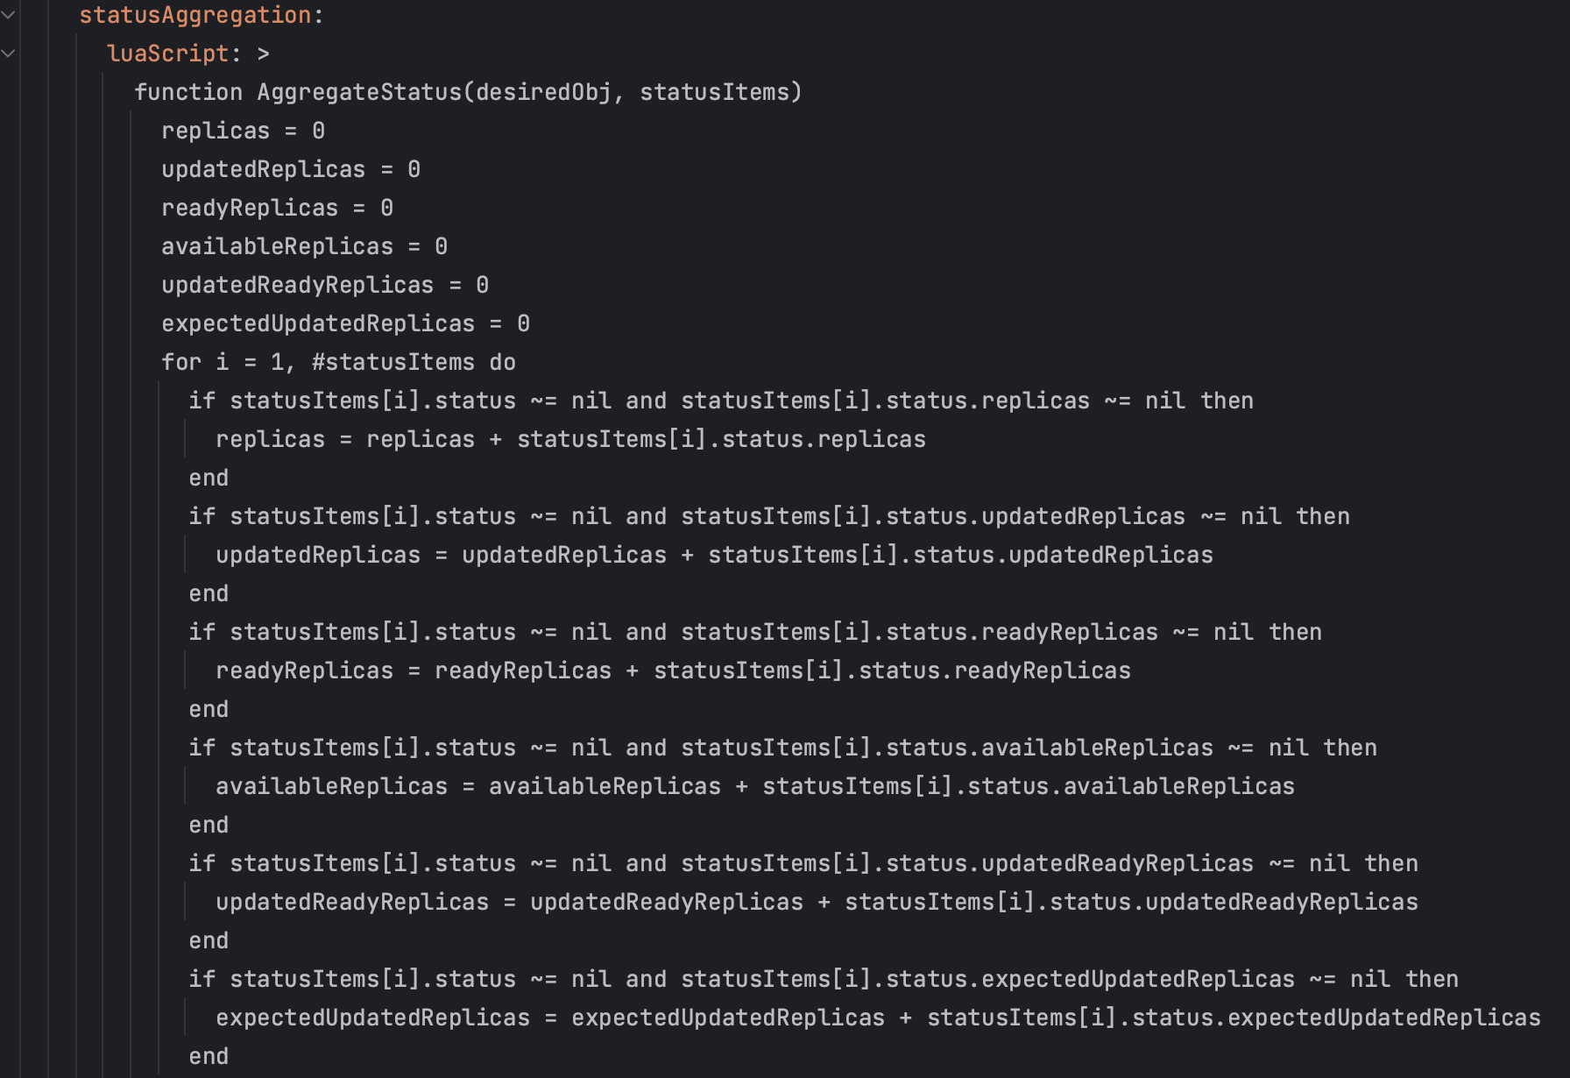
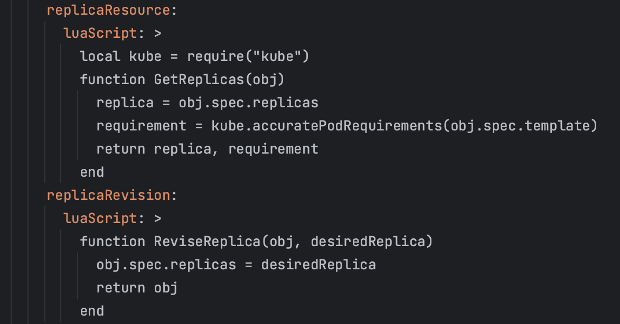
Example Code For CloneSet
AggregateStatus:
InterpretReplicas:

Slide 19
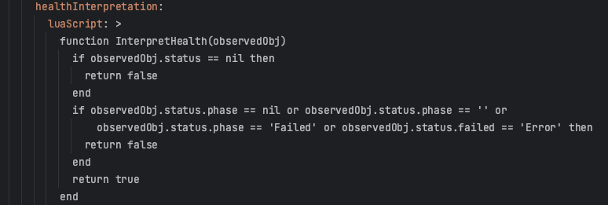
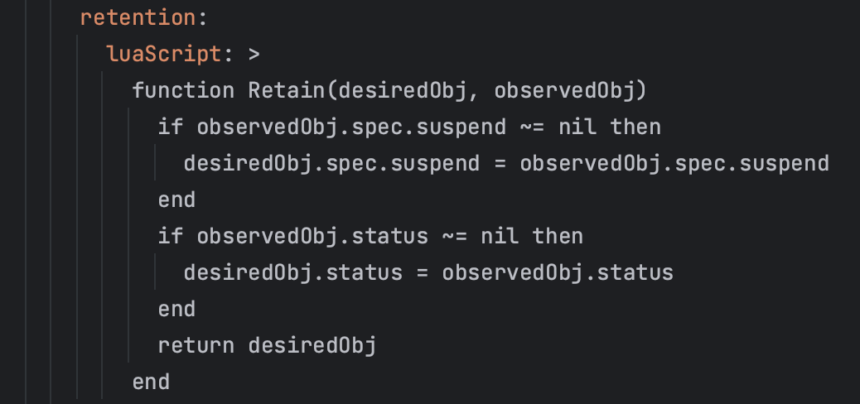
Example Code For Workflow
InterpretHealth:
Retain:

Slide 20
Adoption in vivo

Slide 21

Current status of Container Platform
Multi-Cluster in vivo
Platform provides cluster admin permission import
Each cluster runs independently
Integrate functions such as continuous integration, continuous delivery, and monitoring and alerting
The platform provides the ability to view resource usage across multiple clusters
Aggregation of APIs across multiple clusters
CICD
Container
Platform
Multi-Cluster in vivo
Multi-Cluster Federation in vivo
Federation of Kubernetes resources and other CRD
Unified scheduling
Unified application delivery
Unified application access
FedHpa and CronHpa
Automated intervention for fault handling
CICD
Container
Platform
Federation
Control Plane
Multi-Cluster Federation

Slide 22
Production Factors for Federation cluster
Operators
Network/Storage
Container Platform
Control Plane
1. Federation cluster
monitoring and alerting
Log analysis
Control Plane Operation
1. Multi-cluster networking
Calico
Cloud vendors
1. Multi-cluster Application
Partition Upgrade
Rolling Upgrade
Rollback
1. Multi-cluster scheduling
Cross-cluster scheduling
Rescheduling
Simulation scheduling
2. Cluster Addons
OpenKruise
Argo Workflow
2. Multi-cluster Service Mesh
Istio
Linkerd
Consul
Envoy
2. Application Migration
Online business migration
Online business rollback
2. Multi-cluster RBAC
Unified permission management
Flexible authorization
Security audit and monitoring
3. Multi-cluster search
data query performance
Share and collaborate on data
3. Multi-cluster HPA
FedHPA
CronHpa
Manual scaling
3. Multi-cluster storage
Distributed file system
Data migration
Storage Performance
Storage Capacity
4. Multi-cluster event
Troubleshooting
Data analysis
decision support

Slide 23
Cluster addons OpenKruise
Intro：OpenKruise is an extended component suite for Kubernetes, which mainly focuses on automated management of large-scale applications, such as deployment, upgrade, ops and availability protection.
Openkruise in vivo
CloneSet
Advanced StatefulSet
Container platform function based on Openkruise
Partition upgrade
Rolling upgrade
Rollback by partition
In-place update
MaxUnavailable and MaxSurge
Application traffic is not interrupted
Selective Pod deletion
Scale up with rate limit

Slide 24
Integration OpenKruise
Create Cloneset CR
Create Advanced StatefulSet CR
Federation
Control Plane
Setup OpenKruise
Install Cloneset CRD and Advanced StatefulSet CRD on the Federation
Control plane
Deploy OpenKruise with chart in the member cluster
Custom Cloneset and Advanced StatefulSet Interpreters by Lua scripts
Deploy CloneSet and Advanced StatefulSet
Get Cloneset and Advanced StatefulSet status on the Federation Control plane
Cloneset
Advanced StatefulSet
cloneset
Advanced StatefulSet
cloneset
Advanced StatefulSet

Slide 25
Overview of publishing your Application
Configmap
secret
update(OverridePolicy)
ImageOverrider
in-place update
CommandOverrider
ArgsOverrider
PlaintextOverrider
Rolling upgrade
Partition upgrade
Rollback by partition
MaxUnavailable and MaxSurge
Scale up with rate limit
service
CloneSet
pvc/pv
Service discovery
k8s
game-2408-prd-332212-xxx-cm
game-2408-prd-332212-xxx-svc
game-2408-prd-332212-xxx-secret
game-2408-prd-
2212-cloneset
game-2408-prd-332212-xxx-pvc
game-2408-prd-332212-xxx-crd
Karmada PropagationPolicy /OverridePolicy

Slide 26

Partition Upgrade Case
pod1
pod3
pod2
CICD
Container
Platform
Federation
Control Plane
Cluster A
pod4
pod6
pod5
Update OverridePolicy
Cluster B
OverridePolicy.PlaintextOverrider
{
Path:"/spec/updateStrategy/partition",
Operator: "replace",
Value: 2,
}
TargetCluster.ClusterNames{
ClusterNames: [“clusterA”]
}
OverridePolicy.PlaintextOverrider
{
Path:"/spec/updateStrategy/partition", Operator: "replace",
Value: 2,
}
TargetCluster.ClusterNames{
ClusterNames: [“clusterB”]
}
OverridePolicy.PlaintextOverrider
{
Path:"/spec/updateStrategy/partition", Operator: "replace",
Value: 0,
}
TargetCluster.ClusterNames{
ClusterNames: [“clusterA”，“clusterB”]
}
Update
OverridePolicy
Update
OverridePolicy
Setup1
Upgrade one instance in cluster A
Setup2
Upgrade one instance in cluster B
Setup3
Upgrade two instances in cluster A
Upgrade two instances in cluster B

Slide 27
Online business migration
CI/CD
Migration whitelist
Application
Migration process
Add the application to the migration whitelist
Deploy the application
Manage the application through Karmada
Finally, the application is deployed, and the user is
completely unaware of the migration process.
Both management methods are supported
容器平台
Container
Platform
DB
get whitelist
iskarmada
yes
no
Application being managed
by Karmada
Karmada

Slide 28

Strategies for online business migration
Add many applications
to the whitelist
CICD
Container
Platform
Principles of application migration
Test first, then pre-release, and finally production.
For major changes, perform gradual, staged, and proportional (1:2:7 ratio) gray release migration.
Both parties responsible for the migration should perform point checks, verify, and observe monitoring for 5-10 minutes.
Confirm whether there are any exceptions during the migration. If exceptions are found, follow the rollback process.
Test
Add many applications
to the whitelist
CICD
Container
Platform
Pre
Add many applications
to the whitelist
CICD
Container
Platform
Prd

Slide 29

Online business Rollback
CICD
Remove whitelist/add annotation
isKarmada
DB
container platform
yes
no
Workload
Propagation
Why？
An error occurred during the migration
An unknown error occurred on the control plane
work.karmada.io/update：skip
work
work
defaultinterpreter
exection-controller
Observe the work object annotation
Interrupting member cluster resource management
exection-controller
workload
workload
Service

Slide 30
Q&A

